Slide 1
ETRSS-1 TT&C Module Design
DFH SATELLITE CO.,LTD
February.2019

Slide 2
Terms and Abbreviations
EIRP —— Equivalent Isotropic Radiated Power
OBDH——On Board Data Handling
PCM——Pulse Code Modulation
PM——Phase Modulation
PSK——Phase Shift Keying
SNR——Signal to Noise Ratio
USB——Unified S-band
TC ——Tele-Command
TM ——Telemetry
UTC——Coordinated Universal Time
PAGE 2

Slide 3
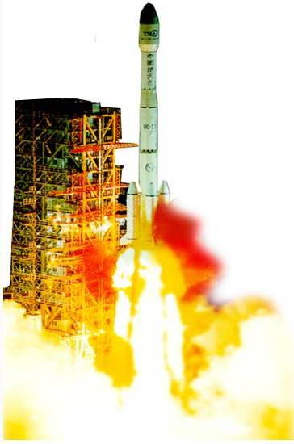


Outlines
1 Introduction
2 Technical Specification Analysis
3 Telemetry And Command
4 Position and Orbit Determination
PAGE 3

Slide 4
1 TT&C Introduction
What is TT&C
Telemetry
Position
Command
TT&C Task
PAGE 4
Notes:
First we should know what is TT&C:
TT&C subsystem is one of the important part of satellite which accomplish command, control when satellite passes over a S-Band Ground Station.

Slide 5
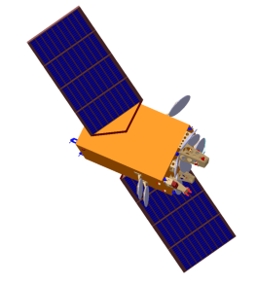

1 TT&C Introduction
TT&C System
Composed
How to complete the TT&C task
TT&C subsystem of satellite
TT&C Subsystem
Ground Station
Ground Station
Command Center
PAGE 5

Slide 6
1 TT&C Introduction
TT&C Significance
know and control the satellite
whole lifecycle
Difference with Payload communication
status data and command data for normal operation
payload data for using
PAGE 6

Slide 7
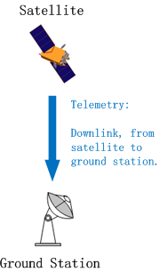
1 TT&C Introduction
Telemetry
status and parameters(PCM)
TM subcarrier(PSK)
Carrier(PM)
downlink channel
PAGE 7

Slide 8
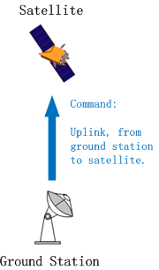
1 TT&C Introduction
Command
uplink channel
demodulated
PAGE 8

Slide 9
1 TT&C Introduction
Difference of Telemetry and Command
Continuity: TM--continuously
TC-- casually
Data rate: Downlink 4.096kbit/s
Uplink: 2kbit/s
PAGE 9

Slide 10
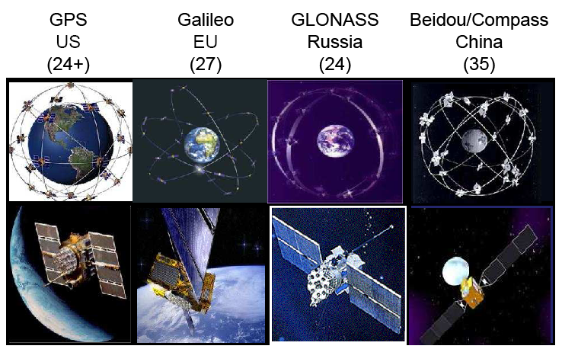
1 TT&C Introduction
position and orbit etermination
Global Position System (GPS)
GPS data transferred
GPS data used by other subsysterms
PAGE 10

Slide 11
Outlines
1 Introduction
2 Technical Specification Analysis
3 Telemetry And Command
4 Positioning and Orbit Determination
PAGE 11

Slide 12
2 Technical Specification Analysis
Task Requirements
Composing of the space part of TT&C system
Fulfilling of telemetry and command tasks
Provide the position, velocity, time
PAGE 12

Slide 13
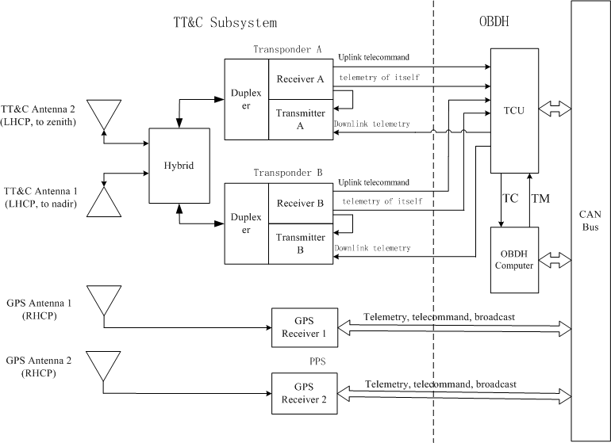
2 Technical Specification Analysis
Equipment Composition
PAGE 13

Slide 14
2 Technical Specification Analysis
Unit Function
Transponder
To transmit telemetry.
GPS receiver
Output position and orbit determination messages
Antenna
The TT&C antenna receives or transmits the TT&C signal.
The GPS antenna receives signals from the GPS navigation satellites.
To receive and demodulate the uplink signals and output PCM signal to OBDH.
Broadcast the PPS signal which synchronizes satellite time
The Multiplexer blends or distributes the TT&C signal.
Broadcast UTC time
PAGE 14

Slide 15
2 Technical Specification Analysis
Primary Performance index of TT&C subsystem
No. | Item | Specification
1 | TT&C Types | USB+GPS
2 | Carrier Frequency | Uplink 2025～2110 MHz, Downlink 2200～2290 MHz
3 | Sub-carrier frequency | Uplink :8 kHz Downlink :65.536 kHz
4 | Turnaround Frequency Ratio | uplink/downlink = 221/240
5 | Modulation Types | Uplink : PCM/BPSK/PM, Downlink: PCM/BPSK/PM
6 | TC Bit Rate | 2000bps
7 | TM Bit Rate | 4096bps
8 | EIRP of satellite | ≥ -13.01 dBW
9 | G/T of satellite | ≥-38.33dB/K
10 | Transponder Sensitivity | ≤-106dBm
11 | GPS position precision | Better than 10 m (1σ, 3-axis)
PAGE 15

Slide 16
2 Technical Specification Analysis
Key parameter design
Carrier Frequency
Need your cooperating for applying frequency
TT&C Link Calculation
TT&C Time analysis
PAGE 16

Slide 17
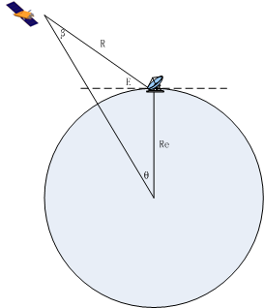
2 Technical Specification Analysis
TT&C Link Calculation
1) Basic calculation
No. | Items | Unit | Value
1 | Altitude of Orbit apogee (ha) | km | 628
2 | Antenna Elevation Of Earth Station ( E ) | º | 5
3 | Maximum Distance Between Satellite And GS( R ) | km | 2396
Law of sin:
PAGE 17

Slide 18
2 Technical Specification Analysis
TT&C Link Calculation
2)
No. | Uplink | Unit | Value
1 | EIRP Of Earth Station ( EIRPg ) | dBW | 47.95
2 | Carrier frequency(Fup) | MHz | 2080
3 | Free space loss(Lspu) | dB | -166.39
4 | Other loss | dB | -2.3
5 | Edge gain of receiving antenna(Grs)s | dBi | -10
6 | Receiver input power(P) | dBW | -126.74
7 | Gain/noise temperature ratio of receiving system（G/T）s | dB/K | -38.33
8 | Signal to noise spectrum density ratio(S/No)s | dBHz | 69.53
9 | Acquisition threshold of Earth Station | dBHz | 44
10 | Acquisition margin (Mats) | dB | 25.53
11 | Telecomand Modulated Loss(Ltc) | dB | -6.66
12 | Signal to noise spectrum density ratio of TC | dBHz | 62.87
13 | TC Bit Rate | dBHz | 33.01
14 | Eb/N0 needed(1*10⁻⁶) | dBHz | 10.5
15 | Telecomand Demodulated Loss(Leq) | dB | 2.5
16 | Margin of Telecomand (Mtc) | dB | 16.86
PAGE 18

Slide 19
2 Technical Specification Analysis
TT&C Link Calculation
3)
No. | Downlink | Unit | Value
1 | Power of satellite | dBW | -3.01
2 | Edge gain of transmitting antenna(Gts) | dBi | -10
3 | EIRP of satellite | dBW | -13.01
4 | Carrier frequency(Fd) | MHz | 2250
5 | Free space loss (Lspd) | dB | -167.08
6 | Other loss | dB | -2
7 | Gain/noise temperature ratio (G/T)g | dB/K | 13.45
8 | Signal to noise spectrum density ratio(S/No)g | dBHz | 59.96
9 | Acquisition threshold of Earth Station | dBHz | 41
10 | Acquisition margin (Matg) | dB | 18.96
11 | Telemetry Modulated Loss(Ltc) | dB | -3.56
12 | Signal to noise spectrum density ratio of TM | dBHz | 56.4
13 | TM Bit Rate | dBHz | 36.12
14 | Eb/N0 needed(1*10⁻⁶) | dBHz | 10.5
15 | Telemetry Demodulated Loss(Leq) | dB | 2.5
16 | Telemetry margin (Mtm) | dB | 7.28
PAGE 19

Slide 20
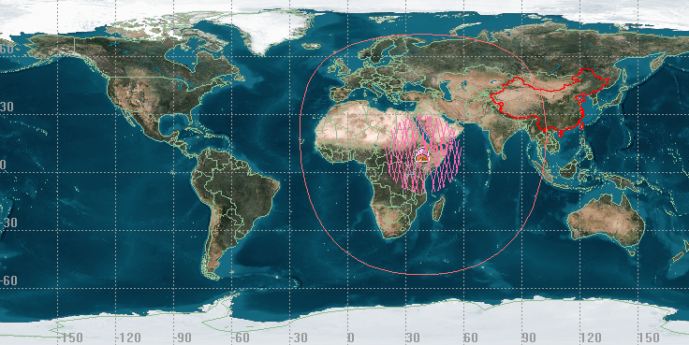
2 Technical Specification Analysis
TT&C Time and Area Analysis
Example :23 Nov 2019 00:00:00.000 UTCG～1 Dec 2019 00:00:00.000 UTCG
FGS | Shortest time（s） | Longest time（s）
Addis Ababa | 234.5 | 640.9
PAGE 20

Slide 21
Outlines
1 Introduction
2 Technical Specification Analysis
3 Telemetry And Command
4 Positioning and Orbit Determination
PAGE 21

Slide 22
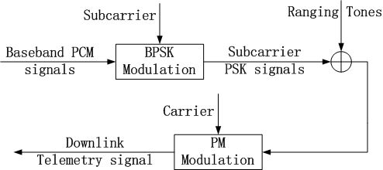
3 Telemetry and Command
USB TT&C Abstract
USB： Unified S Band
Signals modulate：STEP1——STEP2
PAGE 22

Slide 23
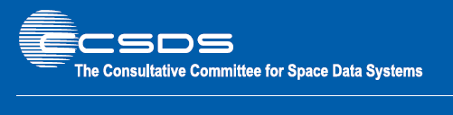
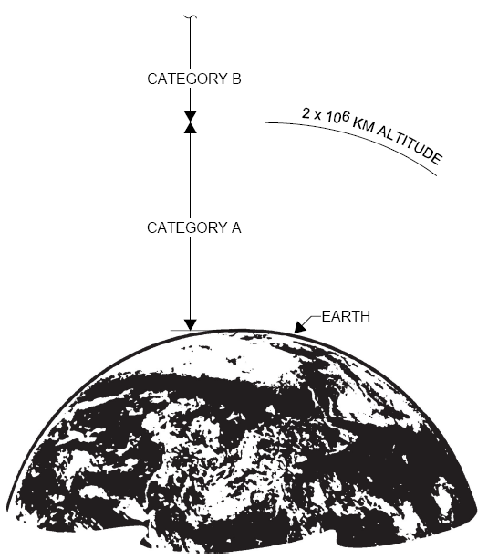
3 Telemetry and Command
Frequency Using Rules
CCSDS
Non-Deep Space spacecraft
Category A ：<2.0×10⁶km
PAGE 23

Slide 24
3 Telemetry and Command
Frequency Using Rules
Coherent turnaround frequency ratio :221/240
Category A spacecraft uplink: 2025~2110 MHz band
Category A spacecraft downlink: 2200~2290 MHz band
Uplink Frequency (MHz) | Downlink Frequency (MHz) | Turnaround Frequency Ratio
2025~2110 MHz | 2200~2290 MHz | 221/240
PAGE 24

Slide 25
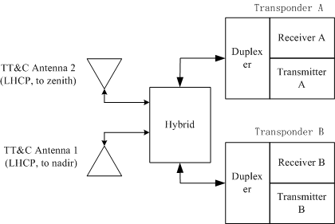
3 Telemetry and Command
Equipment Composition
PAGE 25

Slide 26
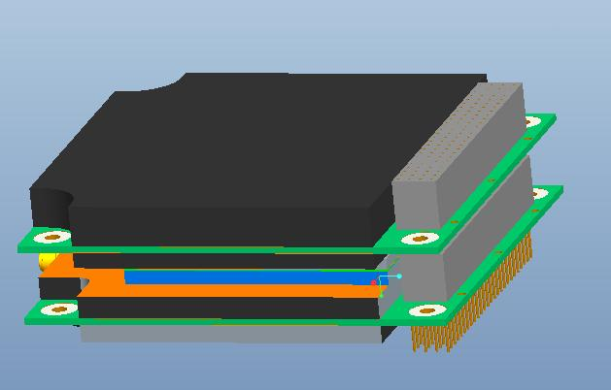
3 Telemetry and Command
S Band Transponder
Function
Modulate TM signals
Demodulate TC signal
Output telemetry information
PAGE 26

Slide 27
2 Technical Specification Analysis
S band Transponder main Performance index
No. | Item | Specification
1 | coherent turnaround frequency ratio | 221/240
2 | Receiving telecommand threshold | better than -106dBm
3 | Receiving Synchronous Bandwidth | better than ±115 kHz
4 | Tracking Rate | better than ± 32 kHz
5 | Dynamic Range of Uplink Power | ≥60 dB
6 | frequency accuracy | better than ±1.5×10⁻⁵
7 | frequency stability | better than 1×10⁻⁷
8 | Tele-command Modulation index | 0.7rad±5%
9 | Telemetry Modulation index | 1.15rad±10%
PAGE 27

Slide 28
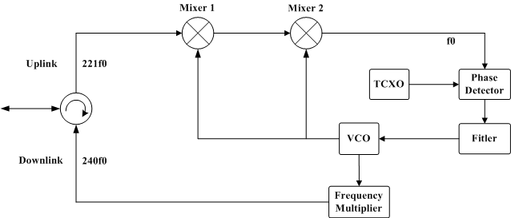
3 Telemetry and Command
coherent turnaround frequency
PAGE 28

Slide 29
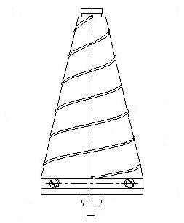
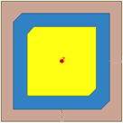
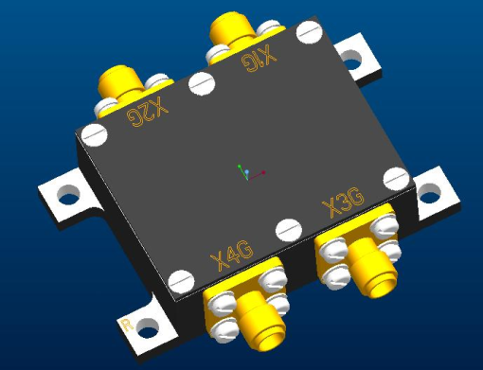
3 Telemetry and Command
TT&C Antenna and hybrid
Function
Transmit downlink signals
Receive up-link signal
Harmonize 2 Signals
TT&C antenna
(to nadir)
TT&C antenna
(to zenith)
Hybrid
PAGE 29

Slide 30
2 Technical Specification Analysis
TT&C Antenna
No. | Item | Specification
1 | Working Frequency | 2025MHz~2290MHz
2 | Operating Mode | Antenna is used both for transmission & receiving
3 | Polarization | Left hand circular polarization (LHCP)
4 | Pattern & Gain | Two-element antenna array provides quasi-omniderictional beam. ∣θ∣≤102.5°：G≥-10dBi； 102.5°<∣θ∣≤112.5°：G≥-12.5dBi； 112.5°<∣θ∣≤180°：G≥-10dBi； Nulls allowed.
5 | VSWR | ≤1.5
PAGE 30

Slide 31
3 Telemetry and Command
S Band Transponder Function
Downlink telemetry function
PAGE 31

Slide 32
3 Telemetry and Command
S Band Transponder Function
Downlink carrier and telemetry function
Fig. The distribution sketch of downlink signal in frequency domain
PAGE 32

Slide 33
3 Telemetry and Command
S Band Transponder Function
Tele-command function
PAGE 33

Slide 34
3 Telemetry and Command
S Band Transponder Function
Tele-command function
Fig. The distribution sketch of uplink signal in frequency domain
PAGE 34

Slide 35
3 Telemetry and Command
Transponder Operation Mode
Mode | Uplink | Downlink | Remark
1 | — | TM | The downlink has beacon and TM signal.
2 | TC | TM | The uplink has TC signal. The downlink has beacon and TM signal.
TM: telemetry; TC: tele-command
PAGE 35

Slide 36
3 Telemetry and Command
Transponder Operation Mode
Mode 1
Early phase of lunch phase
Out of the ground station’s access
Mode 2
When the satellite passing the ground station, and GS is sending TC.
When the satellite just fly into the ground station’s view, and the transponder has not capture the uplink signal.
When the satellite pass the ground station, and there is no TC
Mode 1
TM only for downlink
Mode2
TC for uplink and TM for downlink
PAGE 36

Slide 37
3 Telemetry and Command
Flying Process
TC
Telemetry
Coming
Leaving
Ground Station
PAGE 37

Slide 38
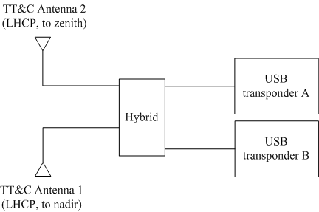
3 Telemetry and Command
The Radiation Pattern of TT&C Antennas
PAGE 38

Slide 39
3 Telemetry and Command
The Radiation Pattern of TT&C Antennas
Uplink
Downlink
Gain pattern of TT&C Uplink frequency
PAGE 39

Slide 40
3 Telemetry and Command
The Radiation Pattern of TT&C Antennas
Explanation
Polar coordinate.
Azimuth.
Direction.
Interference region
Gain pattern of TT&C Uplink frequency
PHI=0°
PAGE 40

Slide 41
Outlines
1 Introduction
2 Technical Specification Analysis
3 Telemetry And Command
4 Positioning and Orbit Determination
PAGE 41

Slide 42
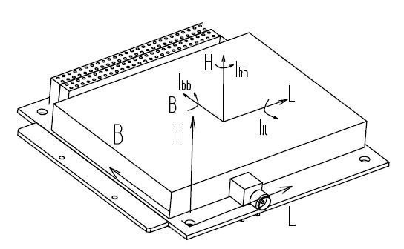
4 Positioning and Orbit Determination
GPS Receiver Function
Calculate the GPS navigational star’s signal and output :
Position data
Orbit
Time
original measurement data
integration time
PAGE 42

Slide 43
4 Positioning and Orbit Determination
Main Performance index of GPS Receiver
No. | Item | Specification
1 | Working Frequency | GPS L1 ( 1575.42±1.023MHz )
2 | Acquisition Threshold | ≤ -160 dBW (L1, C/A Code, Pre-amplifier’s input )
3 | Real-Time Data Accuracy | Position: ≤10m, Velocity: ≤0.2m/s （RMS, three axes composing, 1σ）
4 | Filtering Data Accuracy | Position: ≤7m, Velocity: ≤0.05m/s （RMS, three axes composing, 1σ）
5 | Extrapolating Data Accuracy | Position: ≤7m (in 20s), ≤ 10m (in 20min) Velocity: ≤0.05m/s (in 20s), ≤ 0.2m/s (in 20min) （RMS, three axes composing, 1σ）
6 | Positioning Time | ≤1min
7 | PPS Signal Accuracy | ≤1us
PAGE 43

Slide 44
4 Positioning and Orbit Determination
GPS Receiver Function
Output the telemetry and broadcasting data
Fig. Transmission Sketch of Outputing Telemetry and Broadcasting Data
PAGE 44

Slide 45
4 Positioning and Orbit Determination
No. | Name | Content
1 | quickly changing telemetry packet | work status of GPS receiver.
2 | status slowly changing telemetry packet | status of each module in the GPS receiver.
3 | orbit slowly changing telemetry packet | real-time time-position-velocity data filtering time-position-velocity data 6 orbital elements
4 | position broadcasting packet | time-position-velocity data and the integration time data.
5 | original measurement data broadcasting packet | original measurement information of GPS receiver’s 12 channels.
6 | time broadcasting packet | Shows the PPS signal’s time.
PAGE 45

Slide 46
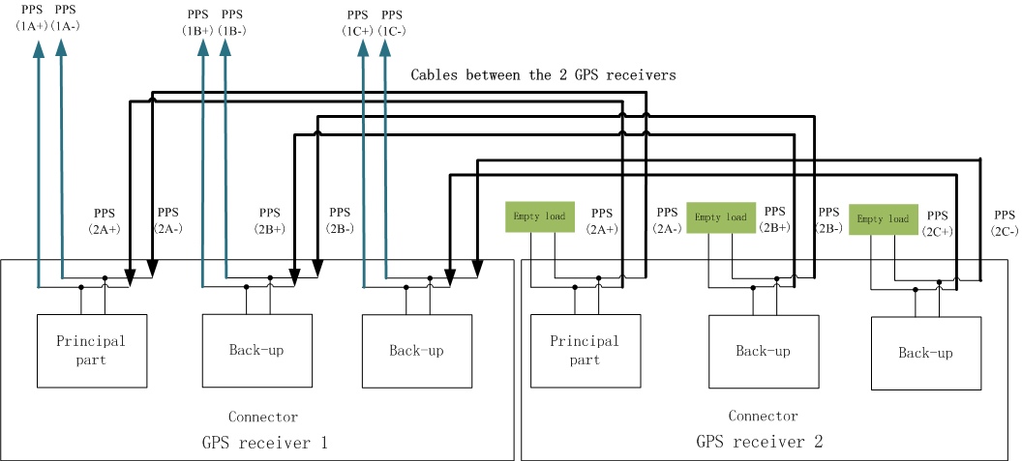
4 Positioning and Orbit Determination
GPS Receiver Function
Output the PPS signal
Fig. Transmission Sketch of GPS Receiver’s PPS Signal
PAGE 46

Slide 47
4 Positioning and Orbit Determination
GPS Receiver Operation Mode
2 operation modes
Real-time mode
Extrapolating mode
The GPS receiver alternates between the 2 modes when in orbit.
PAGE 47

Slide 48
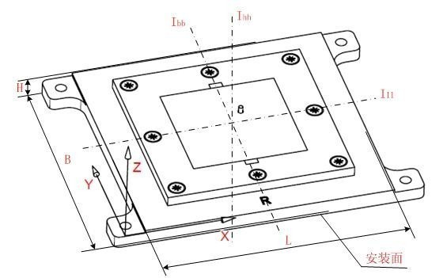
4 Positioning and Orbit Determination
GPS Antennas
PAGE 48

Slide 49
2 Technical Specification Analysis
Main Performance index of GPS Antenna
No. | Item | Specification
1 | Working Frequency | L1: 1575.42±10MHz
2 | Polarization | Right hand circular polarization (RHCP)
3 | Pattern & Gain | L1 frequency（nulls allowed）: ϕ≤360º，0º≤θ≤45º ，G≥-1.0dBi ϕ≤360º，45º≤θ≤75º ，G≥-3.5dBi ϕ≤360º，75º≤θ≤80º ，G≥-5dBi ϕ≤360º，80º≤θ≤90º ，G≥-9dBi
4 | VSWR | ≤1.5
PAGE 49

Slide 50
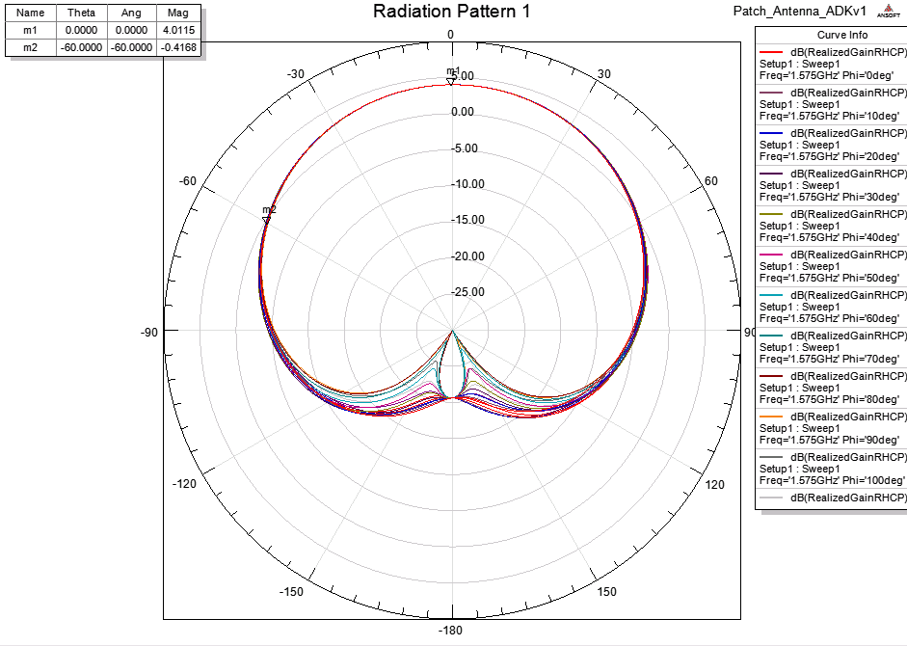
4 Positioning and Orbit Determination
The Radiation Pattern of GPS Antennas
Gain pattern of L1 frequency
PAGE 50

Slide 51
Classroom work
Q1 : Specifies the function of the TT&C subsystem
Q2: Describe the equipments of TT&C Subsystem
Q3: Describe the working mode of transponder
Q4: Specifies TC and TM Signal Character

Slide 52
Thank you

